Slide 1
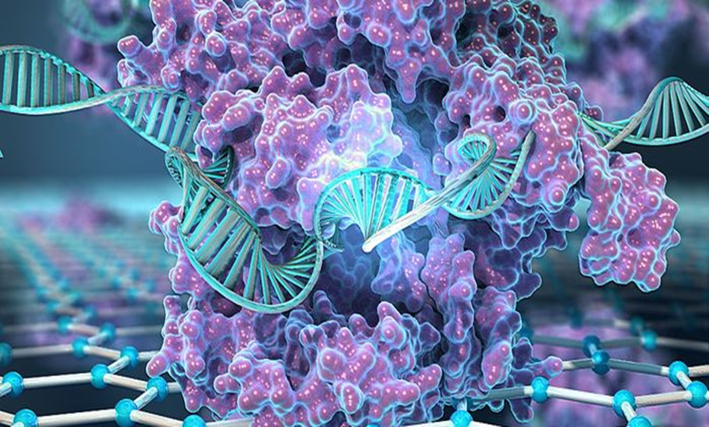
Transcriptomic Data analysis
of Microglial Extracellular Traps
Notes:
ytrfyrf

Slide 2
INTRODUCTION
Extracellular traps are released from cells other than neutrophils, such as eosinophils, basophils, macrophages, mast cells, and monocytes. These extracellular traps get released from various cells in the presence of different stimuli and are also functional. ETs trap and kill pathogens such as bacteria, parasites, fungi, etc., it was discovered that other than the cells mentioned earlier, microglia, one of the immune cells in the brain, also form ETs when induced with dopamine and are functional.
And this microglia is in our case…

Slide 3
OVERVIEW
The datasets that are used for the analysis
− The differential expression data set: https://docs.google.com/spreadsheets/d/1UOzf8j82Oh0jXm7ytCbfvSAWasqb_dDB/edit?usp=drive_link&ouid=110282695971381908203&rtpof=true&sd=true
− The gene expression counts data sets (T vs C): https://docs.google.com/spreadsheets/d/1U3slyfMXFbPol4Y2k0SLAE6khW8NAubF/edit?usp=drive_link&ouid=110282695971381908203&rtpof=true&sd=true
− Also we had inflammation gene data set:
− The complete folder of transcriptomic data analysis: https://drive.google.com/drive/folders/1jqlGw6puj0mTvsS5LoZXTBPYx0K_Ur_2?usp=drive_link

Slide 4
WORKFLOW
1. Differential Expression
2. Error bars
3. KEGG pathway Analysis
4.Gene ontology enrichment analysis
5. Data filtration
6. Heat maps
7. Gene functional annotation

Slide 5
Differential Expression
Based on the fold changes values, we have taken up the data into multiple sets as
1.<= -10 and >= +10
The total number of genes in this range were 19.
2.<= -8 and >= +8
The total number of genes in this range were 361.
3.<= -5 and >= +5
The total number of genes in this range were 3212.

Slide 6
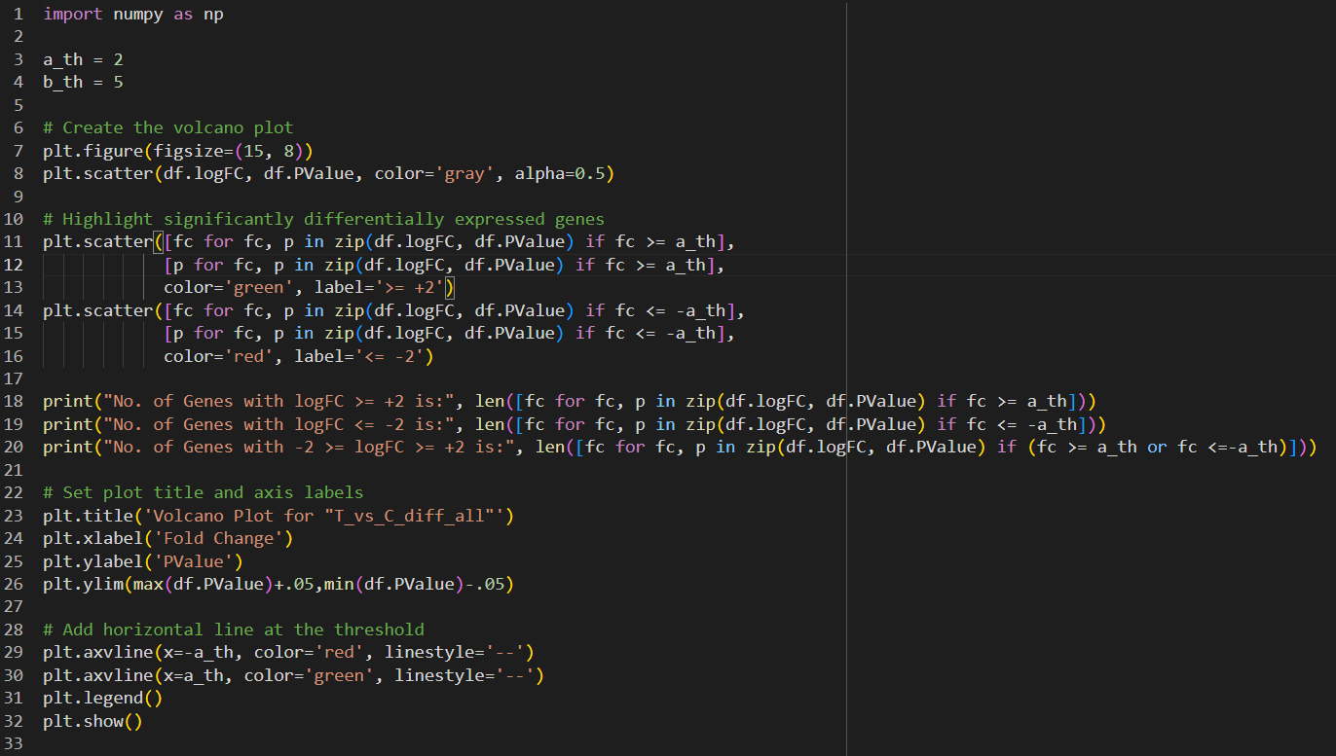
Volcano Plots

Slide 7
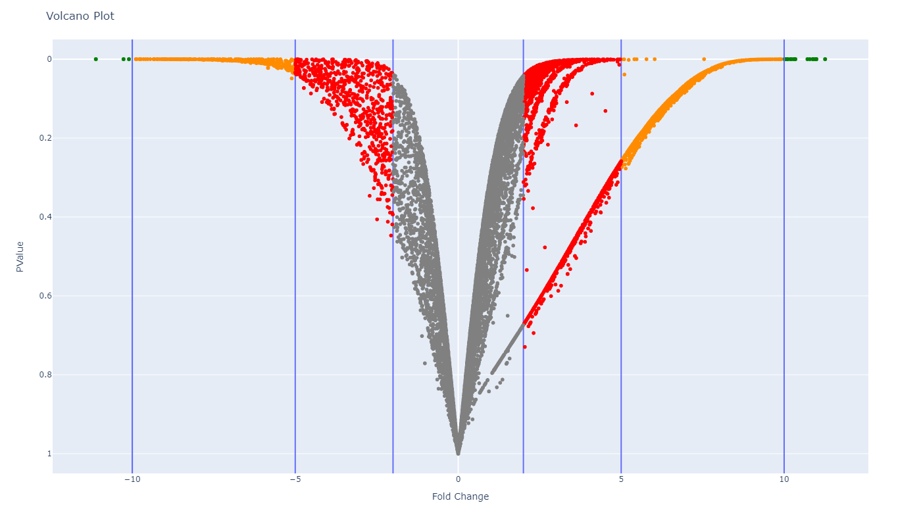

Slide 8
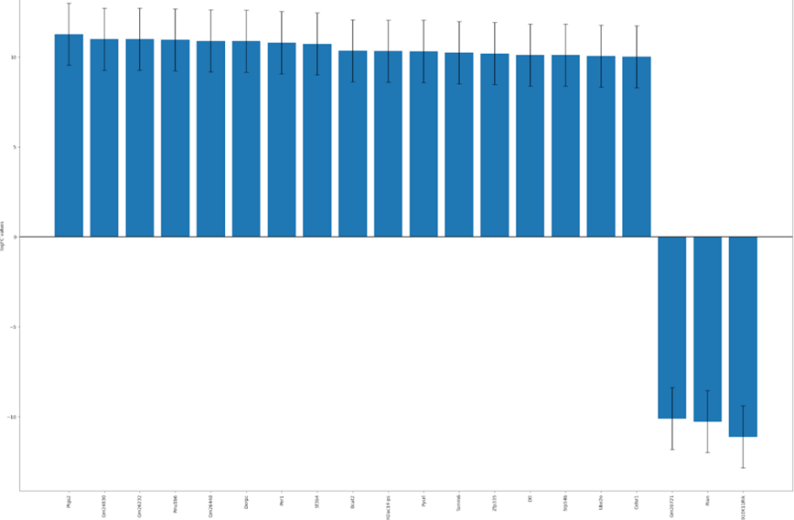
Gene Expression Counts (Error Plots)
Regulation expression bar plot for differentially expressed genes and in the fold change range <= -10 and >= +10.

Slide 9
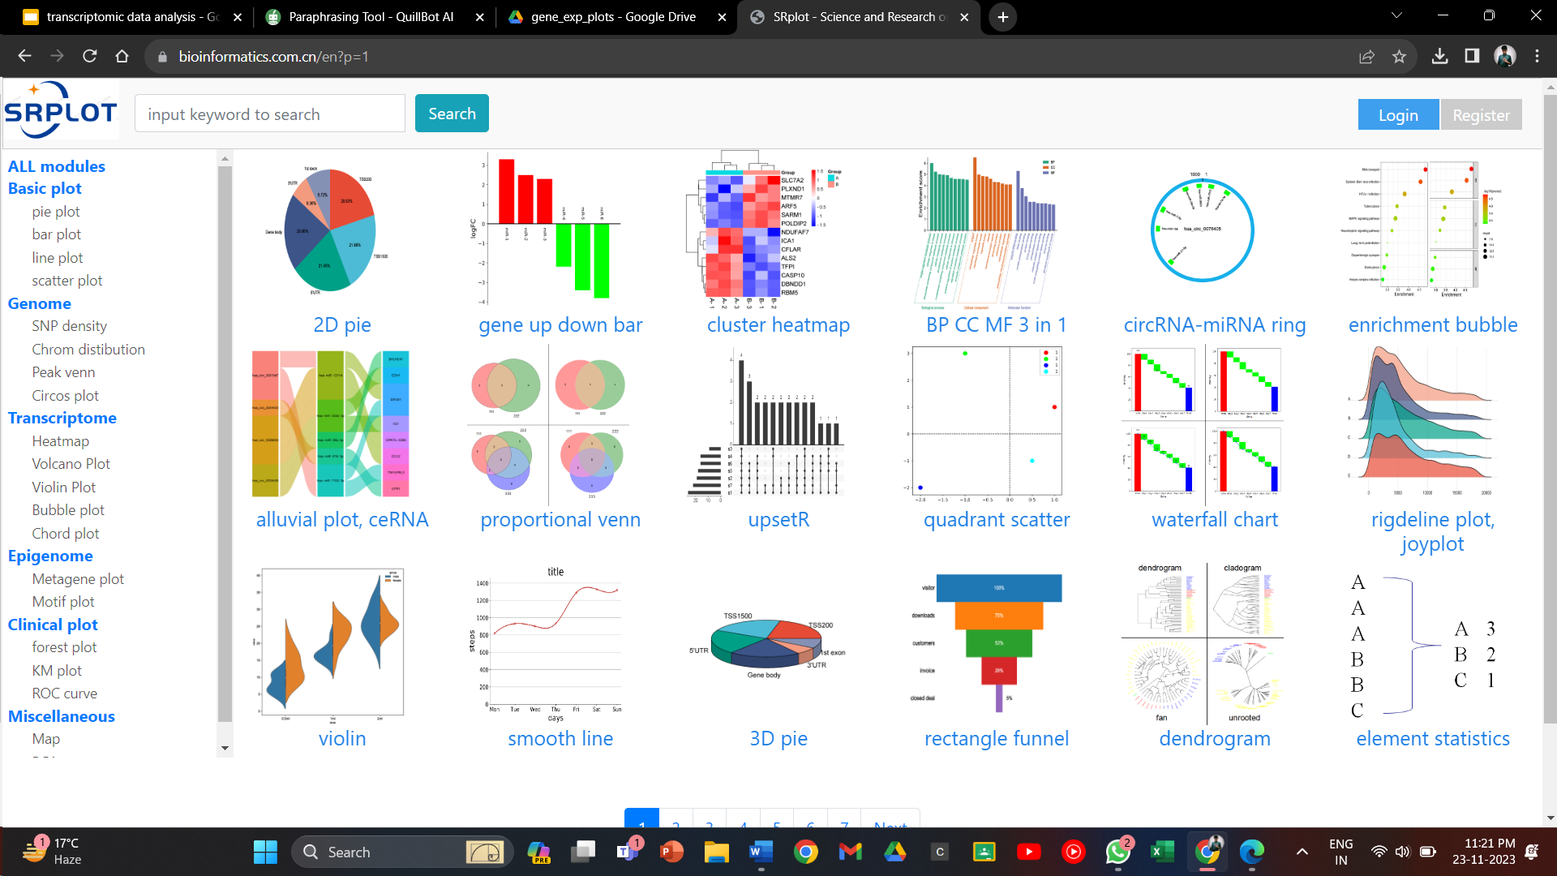
KEGG pathways
We have used SRPLOT, main tool for most of our analysis part

Slide 10
KEGG Pathway Analysis
Firstly, we have filtered the whole data set of differential expression into subsets of ranges <= -5 and >= +5 , <= -8 and >= +8 , and <= -10 and >= +10.
Once the data was filtered, by considering the individual subsets one at a time, we have performed KEGG pathways analysis and Gene ontology enrichment analysis obtained the possible biological pathways.
We have also taken up the genes in the inflammation dataset all at a time and performed both the analysis.

Slide 11
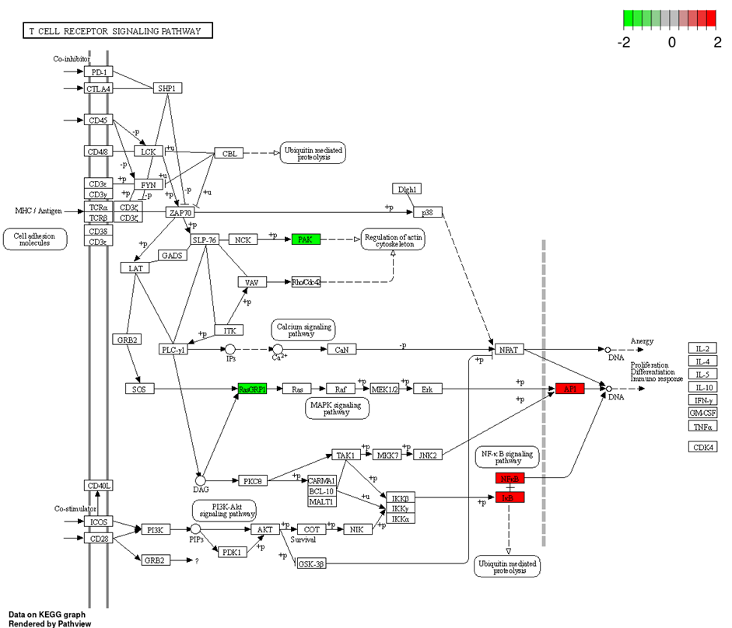
KEGG pathways

Slide 12
KEGG Pathway Analysis
For the set of <= -8 and >= +8
1. Adrenergic signaling in cardiomyocytes
2. Amphetamine addiction
3. cAMP signaling pathway
4. Circadian entrainment
5. GABAergic synapse
6. Insulin secretion
7. Leishmaniasis
8. Morphine addiction
9. Nicotine addiction
10. Retrograde endocannabinoid signaling
For the set of <= -10 and >= +10
1. 2−Oxocarboxylic acid metabolism
2. Arginine and proline metabolism
3. Biosynthesis of amino acids
4. Circadian rhythm
5. Cysteine and methionine metabolism
6. Pantothenate and CoA biosynthesis
7. Protein export
8. Regulation of lipolysis in adipocytes
9. Valine, leucine and isoleucine degradation
10. VEGF signaling pathway
For the set of inflammation genes
1. C−type lectin receptor signaling pathway
2. Cytokine−cytokine receptor interaction
3. Cytosolic DNA−sensing pathway
4. IL−17 signaling pathway
5. Inflammatory bowel disease
6. Influenza A
7. JAK−STAT signaling pathway
8. Legionellosis
9. NOD−like receptor signaling pathway
10. Pertussis

Slide 13
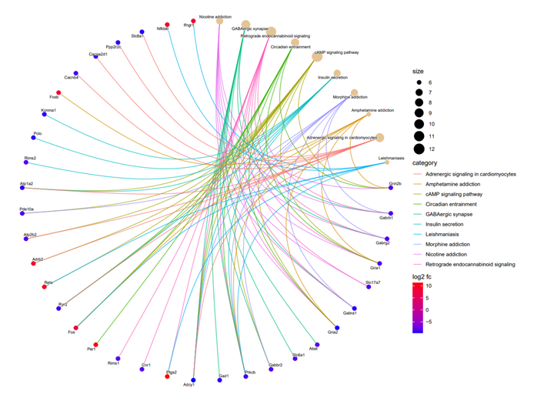
Network representation of top 10 pathways (+-8)

Slide 14
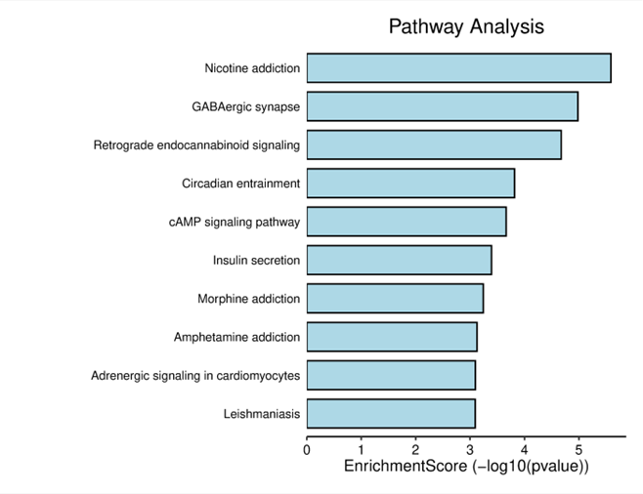
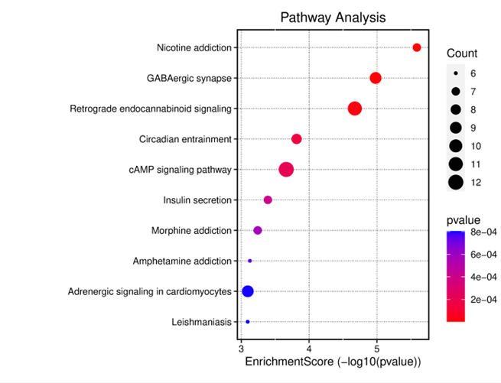
Enrichment score of KEGG pathways

Slide 15
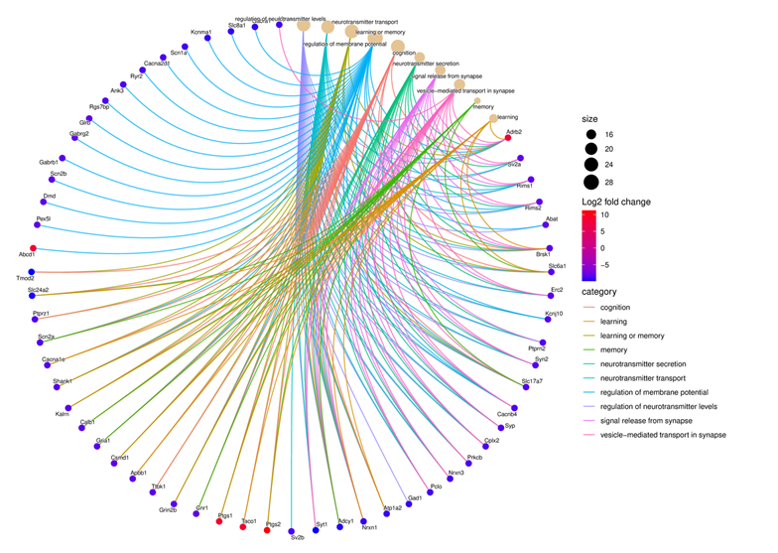
Network representation of top 10 biological processes
Similarly, we also made the network representation of Cellular components and Molecular functions

Slide 16
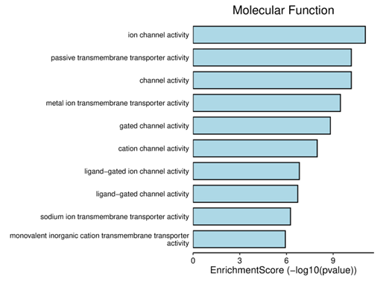
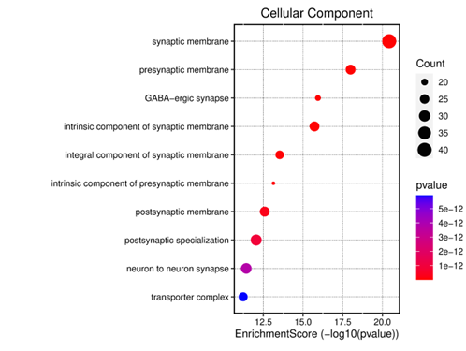
Enrichment scores for BP, CC and MF

Slide 17
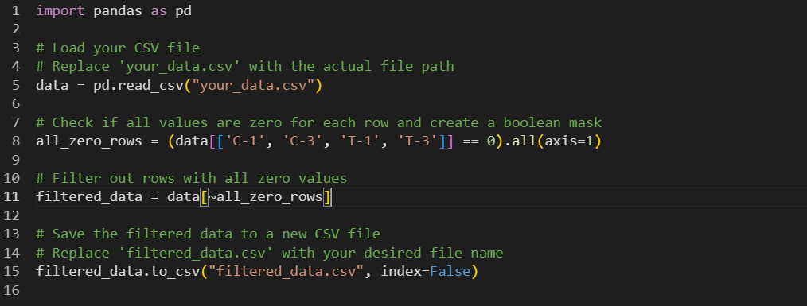
Data filtration
Removed all those genes that have all the values zero or has no notable change even after treatment.

Slide 18
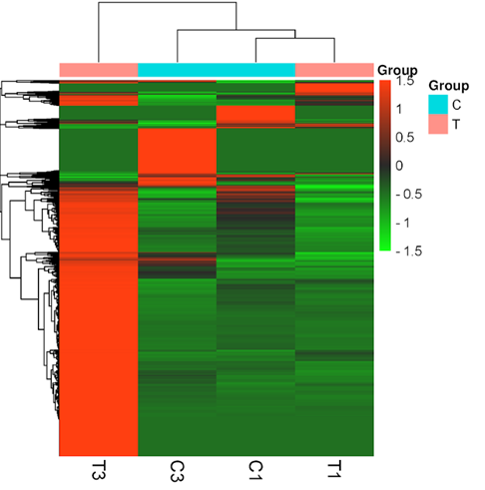
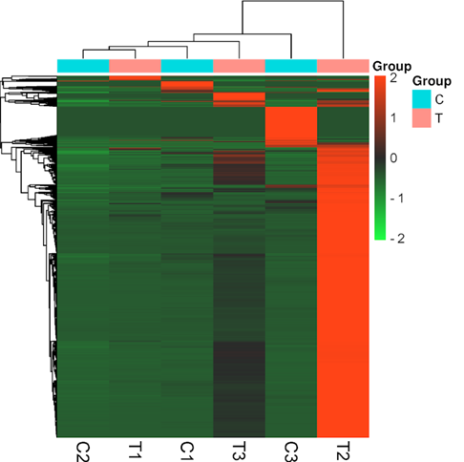
HEAT MAPS
taking up the controls and test samples where for three set of control samples C1, C2, and C3; there was a change only in T1 and T3. The C2 versus T2 sample set has no changes even after the treatment.

Slide 19
Gene Functional Annotation
Gene annotation of <= -10 and >= +10 & <= -8 and >= +8 genes has already been finished (already on the drive).
Currently we are working on the gene annotation of the <= -5 and >= +5 genes.
We have done nearly 50% percent of the work. (nearly 1500 genes out of 3213)
Link - https://docs.google.com/spreadsheets/d/1-O08_dkxZpd3eldwqVXm5lTq0P4LVZVzy0GPTWdiPaU/edit#gid=0
Next, we will finish with T vs C <=5 and >=5 genes, from which quite a few of the genes are overlapping with the ones in the sheet above. (in a week’s time)
Link - https://docs.google.com/spreadsheets/d/12QZktDzRentn-8Y9yglKAEy6OvnuQebt/edit#gid=1191580863

Slide 20
Work Distribution
Rahul Naik: Gene expression counts, Error plots, later moved to work on image data set
Megavath Pavan: Differential Expression (Volcano plots), Gene expression counts, Error plots, Data filtration
Jarpala Ashok: KEGG pathway analysis, Gene ontology, Enrichment analysis, Data Filtration, Heatmaps, Gene functional annotations
Devansh Shah: Heatmaps, Gene functional annotations
Ritu Badgoti: Gene functional annotations
Aditya Parkhi: Gene functional annotations
Pooja Porwal: Gene functional annotations

Slide 21
THANK YOU

